Slide 1
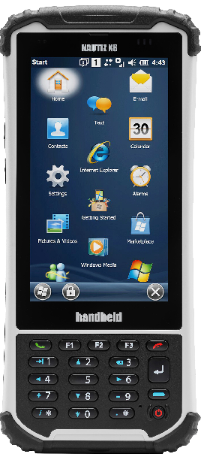
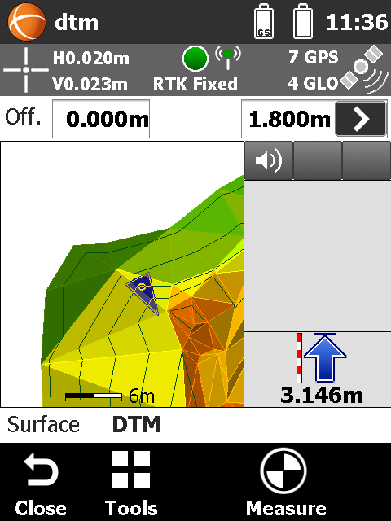
GeoMax Field Controller Zenius8 Product Presentation V 1.0

Slide 2
GeoMax Zenius8 What is it?
Premium Class FieldController
Long Range Bluetooth Cap *
Extra large 4.7" screen
8 M Pix Camera
Rain-/ wet mode
Large Memory
(1 GB RAM, 4 GB Storage)
WinMobile & Android OS
MicroSD Card slot
OS customized for GeoMax
RS232/USB/WiFi/ Bluetooth
Hot swapable batteries
56 Channel GNSS
7-8 h Operating time
Very Robust
IP67
Vibration MIL Std.
Light weight
(490 g)
* optional

Slide 3
GeoMax Zenius8 Delivery contents
Qty | Description | Image
1 | GeoMax Zenius8
1 | Battery Li-Ion, 5.2 Ah
1 | Capacitive stylus
1 | USB Host-USB Mini cable
1 | USB charging cable with EU/UK/US/AUS power adapter
1 | Hand strap
1 | Quick Guide

Slide 4
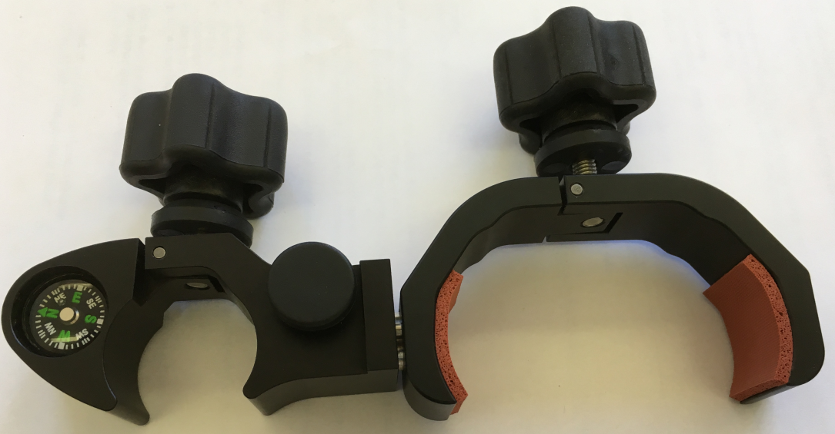
GeoMax Zenius8 Accessories
Art.No | Description | Image
864557 | Long Range Bluetooth Cap
864559 | Battery Li-Ion, 5.2 Ah
864561 | Car-Charger
864562 | Holder

Slide 5
GeoMax Zenius8 Marketing Material & more
Description
Product Overview & Positioning
Competitive overview (xls sheet)
Image Library
User Manual
Quick Guide
OS Win→ Android conversion guide
GeoMax OS
All data available on the GeoMax website

